Slide 1


Conservation of Seamounts with MPAs
Albrecht Götz, Sven Kerwath, Anthony Bernard and Toufiek Samaai
definitions
origin
importance
oceanography
ecology
conservation
case studies

Slide 2
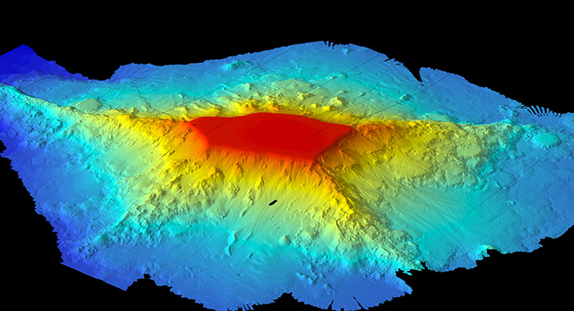
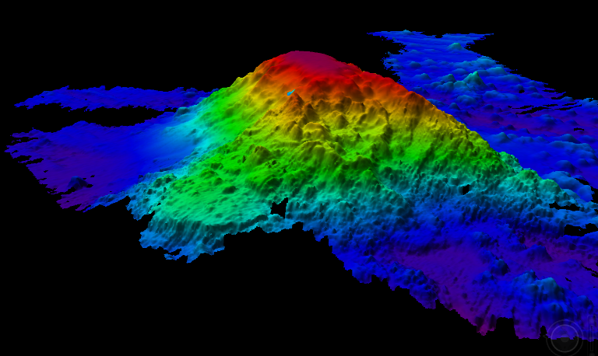
Definitions – Seamounts, Knolls and Pinnacles
1000m
continental
shelf
PINNACLE
SEAMOUNT
KNOLL
abyssal plain
Table (guyot)
Cone (mount)
Notes:
Seamounts are defined as isolated bathymetric structures that rise at least 1000m from the surrounding seafloor without braking the surface of the water.
Structures smaller than that are termed ‘knolls’ or ‘pinnacles’ with the latter being at the smaller end of the spectrum (there is no clear break in height).
The shapes of these structures are variable and related to their geological past with table- and cone-shapes representing the extremes.
In the following I focus on seamounts as they epitomize the aspects described for such ‘topographies’.

Slide 3
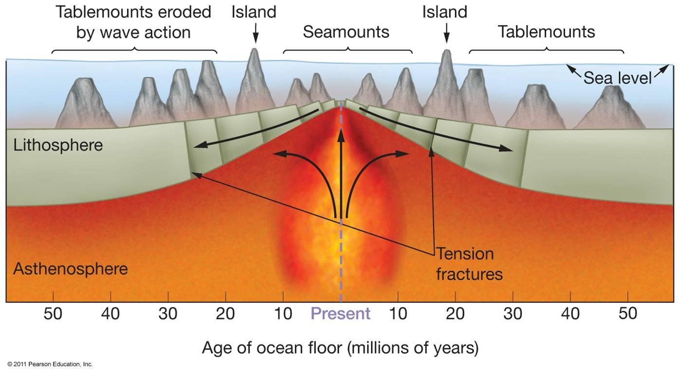
Origin – Seamounts
Notes:
Typically formed through volcanic activity at mid-oceanic ridges or hotspots.
Newly formed seamounts often break the surface of the water (i.e. form islands), but subside later on when the volcanic site cools down. In these cases wave erosion may have flattened the seamount summit to become a tablemount. Recent variations in sea-level height (e.g. caused by glacial periods) may have had similar effects.

Slide 4
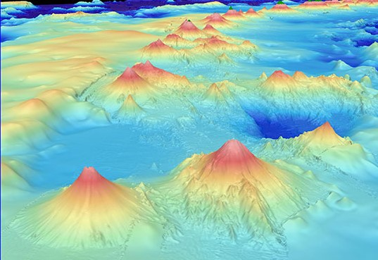
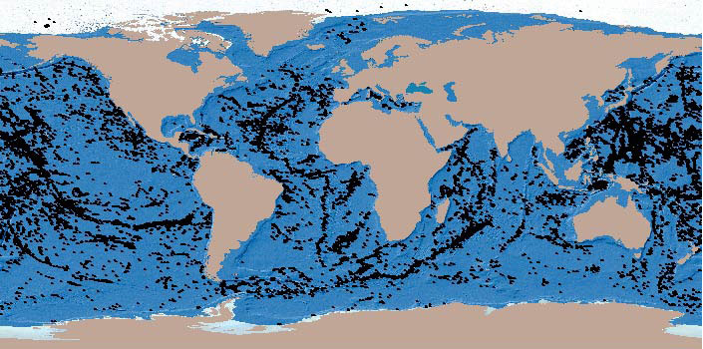
Importance - Seamounts
Global distribution
Considered a biome
Size of Australia or the rainforest biome
Most under-sampled biome
Targeted by offshore fisheries
Notes:
Globally, more than 45,000 seamounts => geographic footprint of all seamounts is larger than the area of Australia (~8mio km²; see inserts).
Seamounts are considered a unique biome comparable in extent to the terrestrial rainforest biome.
With less than 300 seamounts (<0.05%) sampled to date it is by far the least explored biome globally.
Exploited by large offshore fisheries targeting a large number of fish and invertebrates.
Due to the majority of seamounts being situated in international waters these fisheries are poorly managed.

Slide 5
Oceanography - Seamounts
Nutrient-rich upwelling may support higher productivity at seamounts compared to abyssal/open water surroundings
Current amplification benefits resident animals
Taylor Column increases residency time of plankton bloom
Taylor Column
(southern hemisphere)
Notes:
Cold nutrient-rich water is ‘forced’ up by topographic features such as seamounts.
Seamounts are hotspots for productivity as nutrient-rich water from large abyssal areas enters the photic zone.
Amplification of currents around seamounts enhances population growth of resident animals by boosting the supply rate of suspended food.
Larger seamounts and the formation of Taylor Columns (see slide) lead to higher productivity as the enrichment in primary production can propagate up the local food web.

Slide 6
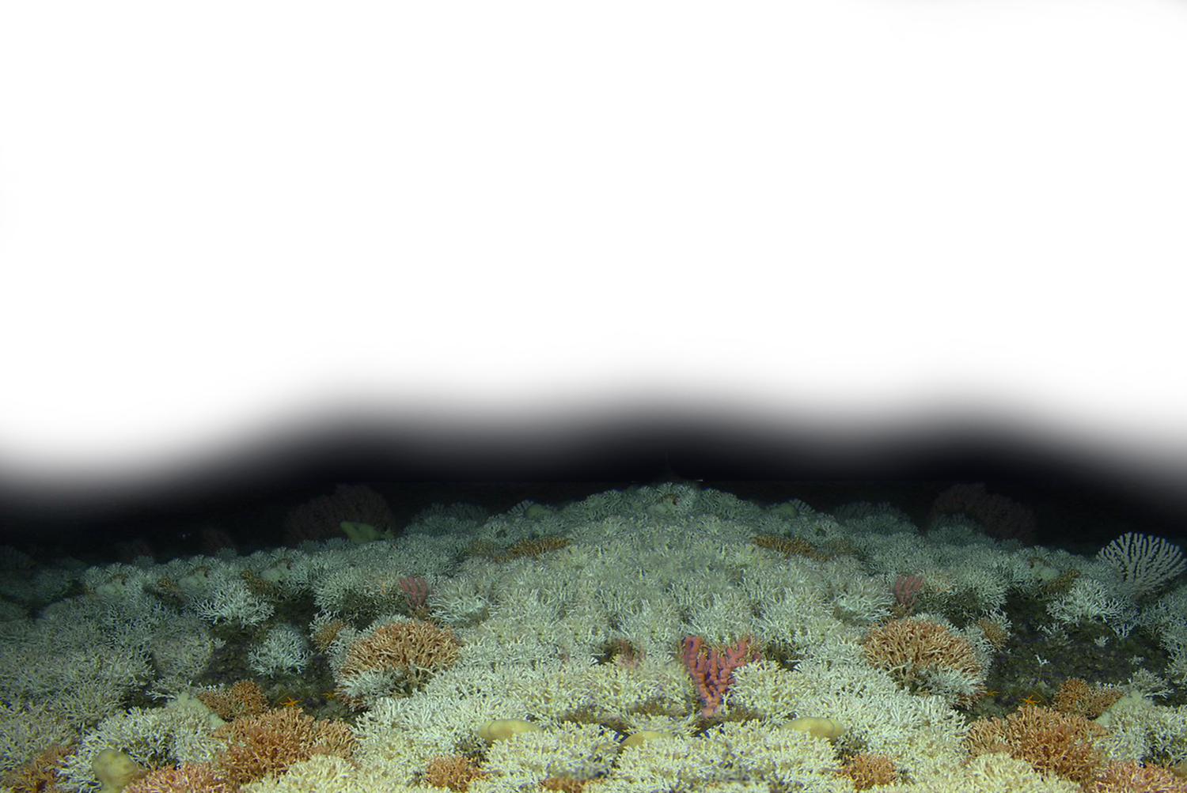
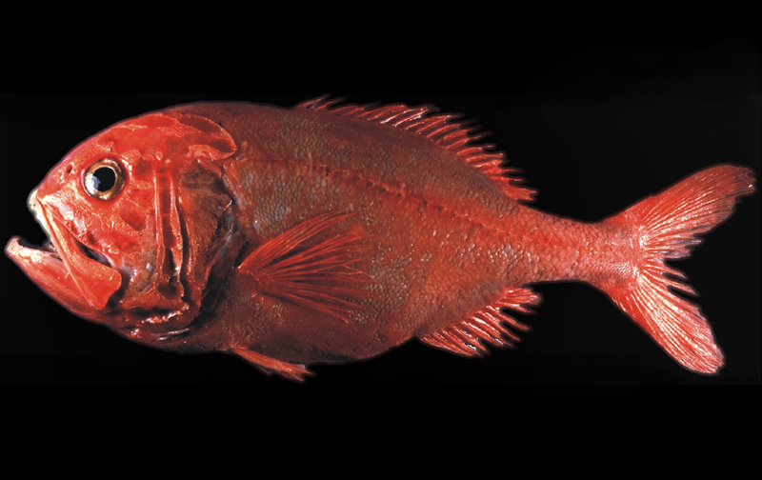
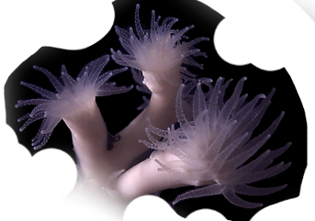
Ecology - Seamounts
Unique cold-water reef ecosystem
High productivity through upwelling
Increased biodiversity and biomass of plankton, invertebrates, fish, mammals and birds
Partly also due to aggregation function
Biogeography of ‘submarine islands’ and endemism
orange roughy
Lophelia pertusa
Notes:
Due to their bathymetric characteristics, seamounts are unique cold water reef ecosystems where organisms grow more slowly, take longer to reach sexual maturity and live longer than warm‐adapted reef species.
For example, Lophelia pertusa (see slide), the most widespread reef-forming cold‐water coral in the world, is an extremely slow growing seamount species with individual coral bushes as old as 1,000 years.
Or, the orange roughy (Hoplostethus atlanticus; see slide), which can live up to 150 years and occurs in great numbers around seamounts.
The higher productivity supports higher biomass of invertebrates, fish, marine mammals and seabirds then the surrounding areas.
As a result seamounts are biodiversity hotspots compared to the surrounding abyssal areas.
They may also act as fish attraction devices or FADs. Certain species of fish aggregate around seamounts to spawn and many marine animals may use them as stop-overs during oceanic migrations.
Because of their relative isolation as ‘submarine islands’ seamounts possibly have biogeographic importance and increased levels of endemism, but current data is not conclusive.

Slide 7
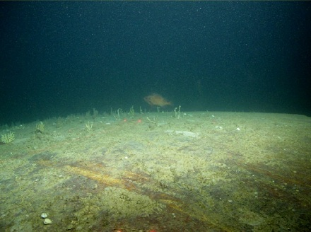
`
Conservation - Seamounts
Extremely vulnerable to disturbances such as trawling
Conservation hampered by international waters
Notes:
Seamount communities are particularly vulnerable to destructive fishing practices such as trawling which can clean a seamount of most of its life (see slide; NB scars from trawl-gear).
Trawling, by far the most popular fishing technique on seamounts, has had devastating effects on exploited resources and biodiversity: on seamounts that have been trawled within the last century, fish and invertebrate communities have not even started to recover.
Invertebrate species such as Lophelia will take centuries to regrow to a pristine population biomass.
The orange roughy was one of the first seamount fish species to be exploited commercially and was soon heavily overfished with no hope for recovery in our lifetime.

Slide 8
Conservation - Seamounts
Notes:
International efforts to close seamounts and surrounding areas have had different levels of success.
For example, a successful protection of seamounts has occurred around New Zealand, all within the Exclusive Economic Zone (EEZ; lighter blue line).
However, in many cases around the world, a change of government and lobbying of the mining and fishing industries have reversed seamount MPAs within the EEZs of countries.
Furthermore, the establishments of seamount MPAs in international waters is of course even less supported and also lacks any ultimately binding legal foundations.

Slide 9
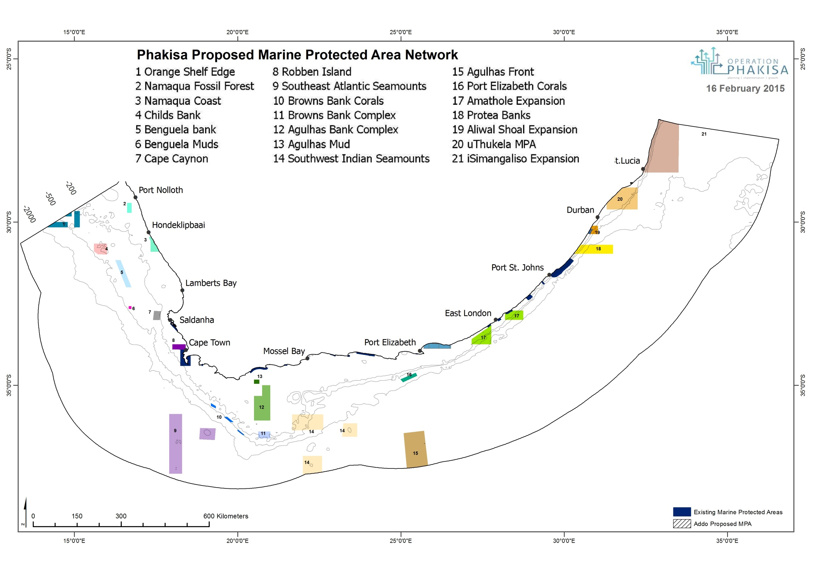
Notes:
In South Africa ‘Operation Phakiza’ has proposed the closure of large offshore areas including substantial pinnacles on the continental shelf (#12 Agulhas Bank Complex MPA).
Several scientific cruises to these pinnacles on the Agulhas Bank between 2008 and 2010 provided scientific information supporting the proposal of the Agulhas Bank Complex MPA.

Slide 10
Case Study - Pinnacles
Pinnacles of the Alphard Bank on the Agulhas Bank, South African Exclusive Economic Zone (EEZ)

Slide 11
Cape Town
Alphard Bank
A g u l h a s B a n k
Notes:
Alphard Bank about 65 km offshore on the Agulhas Bank.

Slide 12
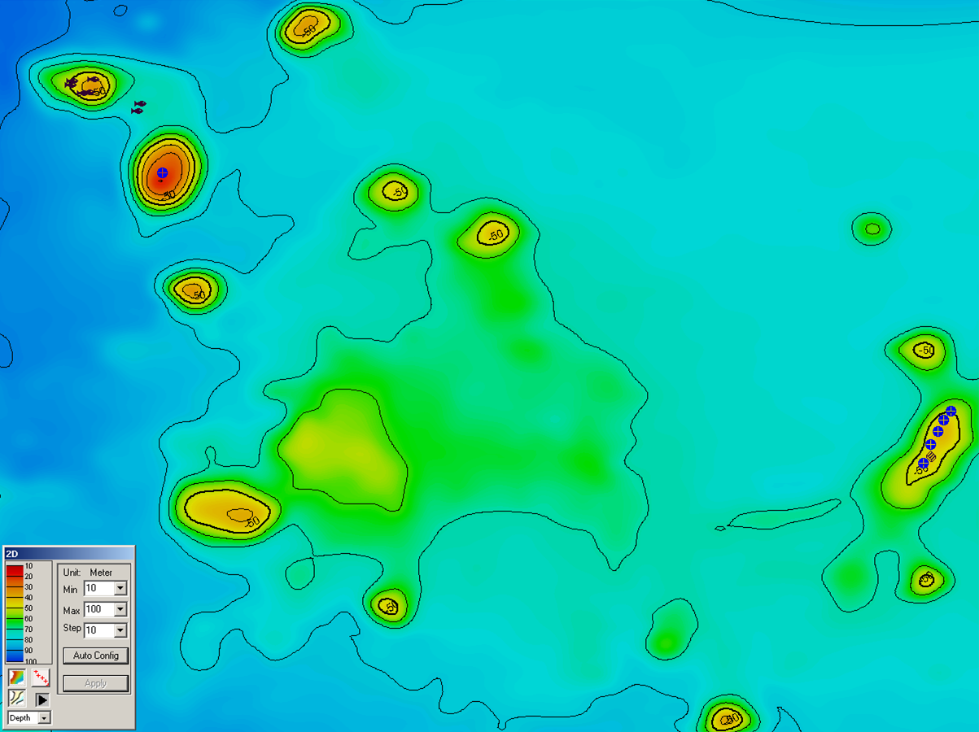
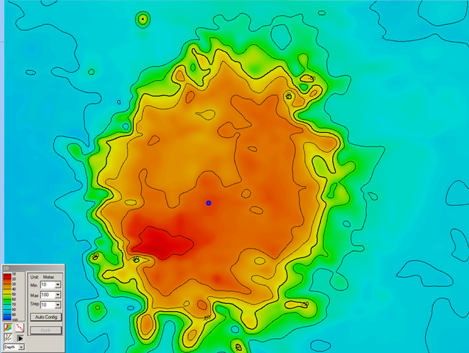
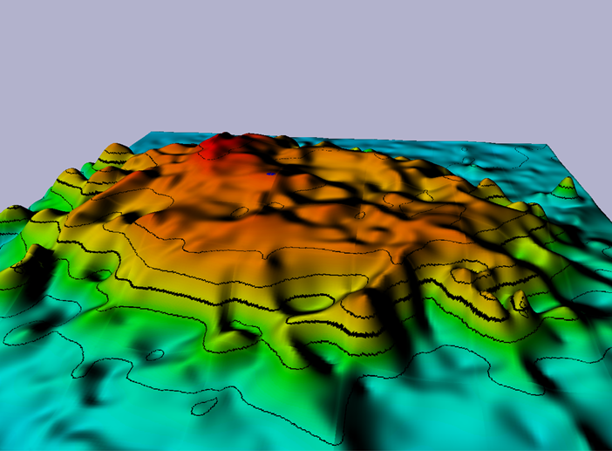
Notes:
Cluster of slender, volcanic pinnacles about 12km across
Rising from 100m to as shallow as 20m under sea surface

Slide 13
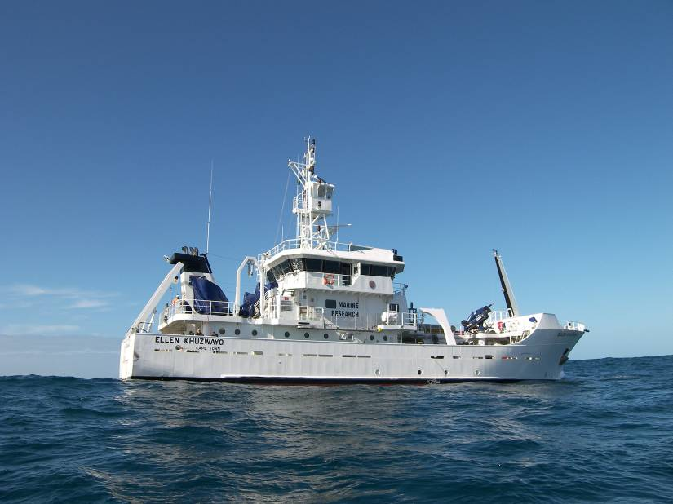
Notes:
Research vessel was the Ellen Khuzwao

Slide 14
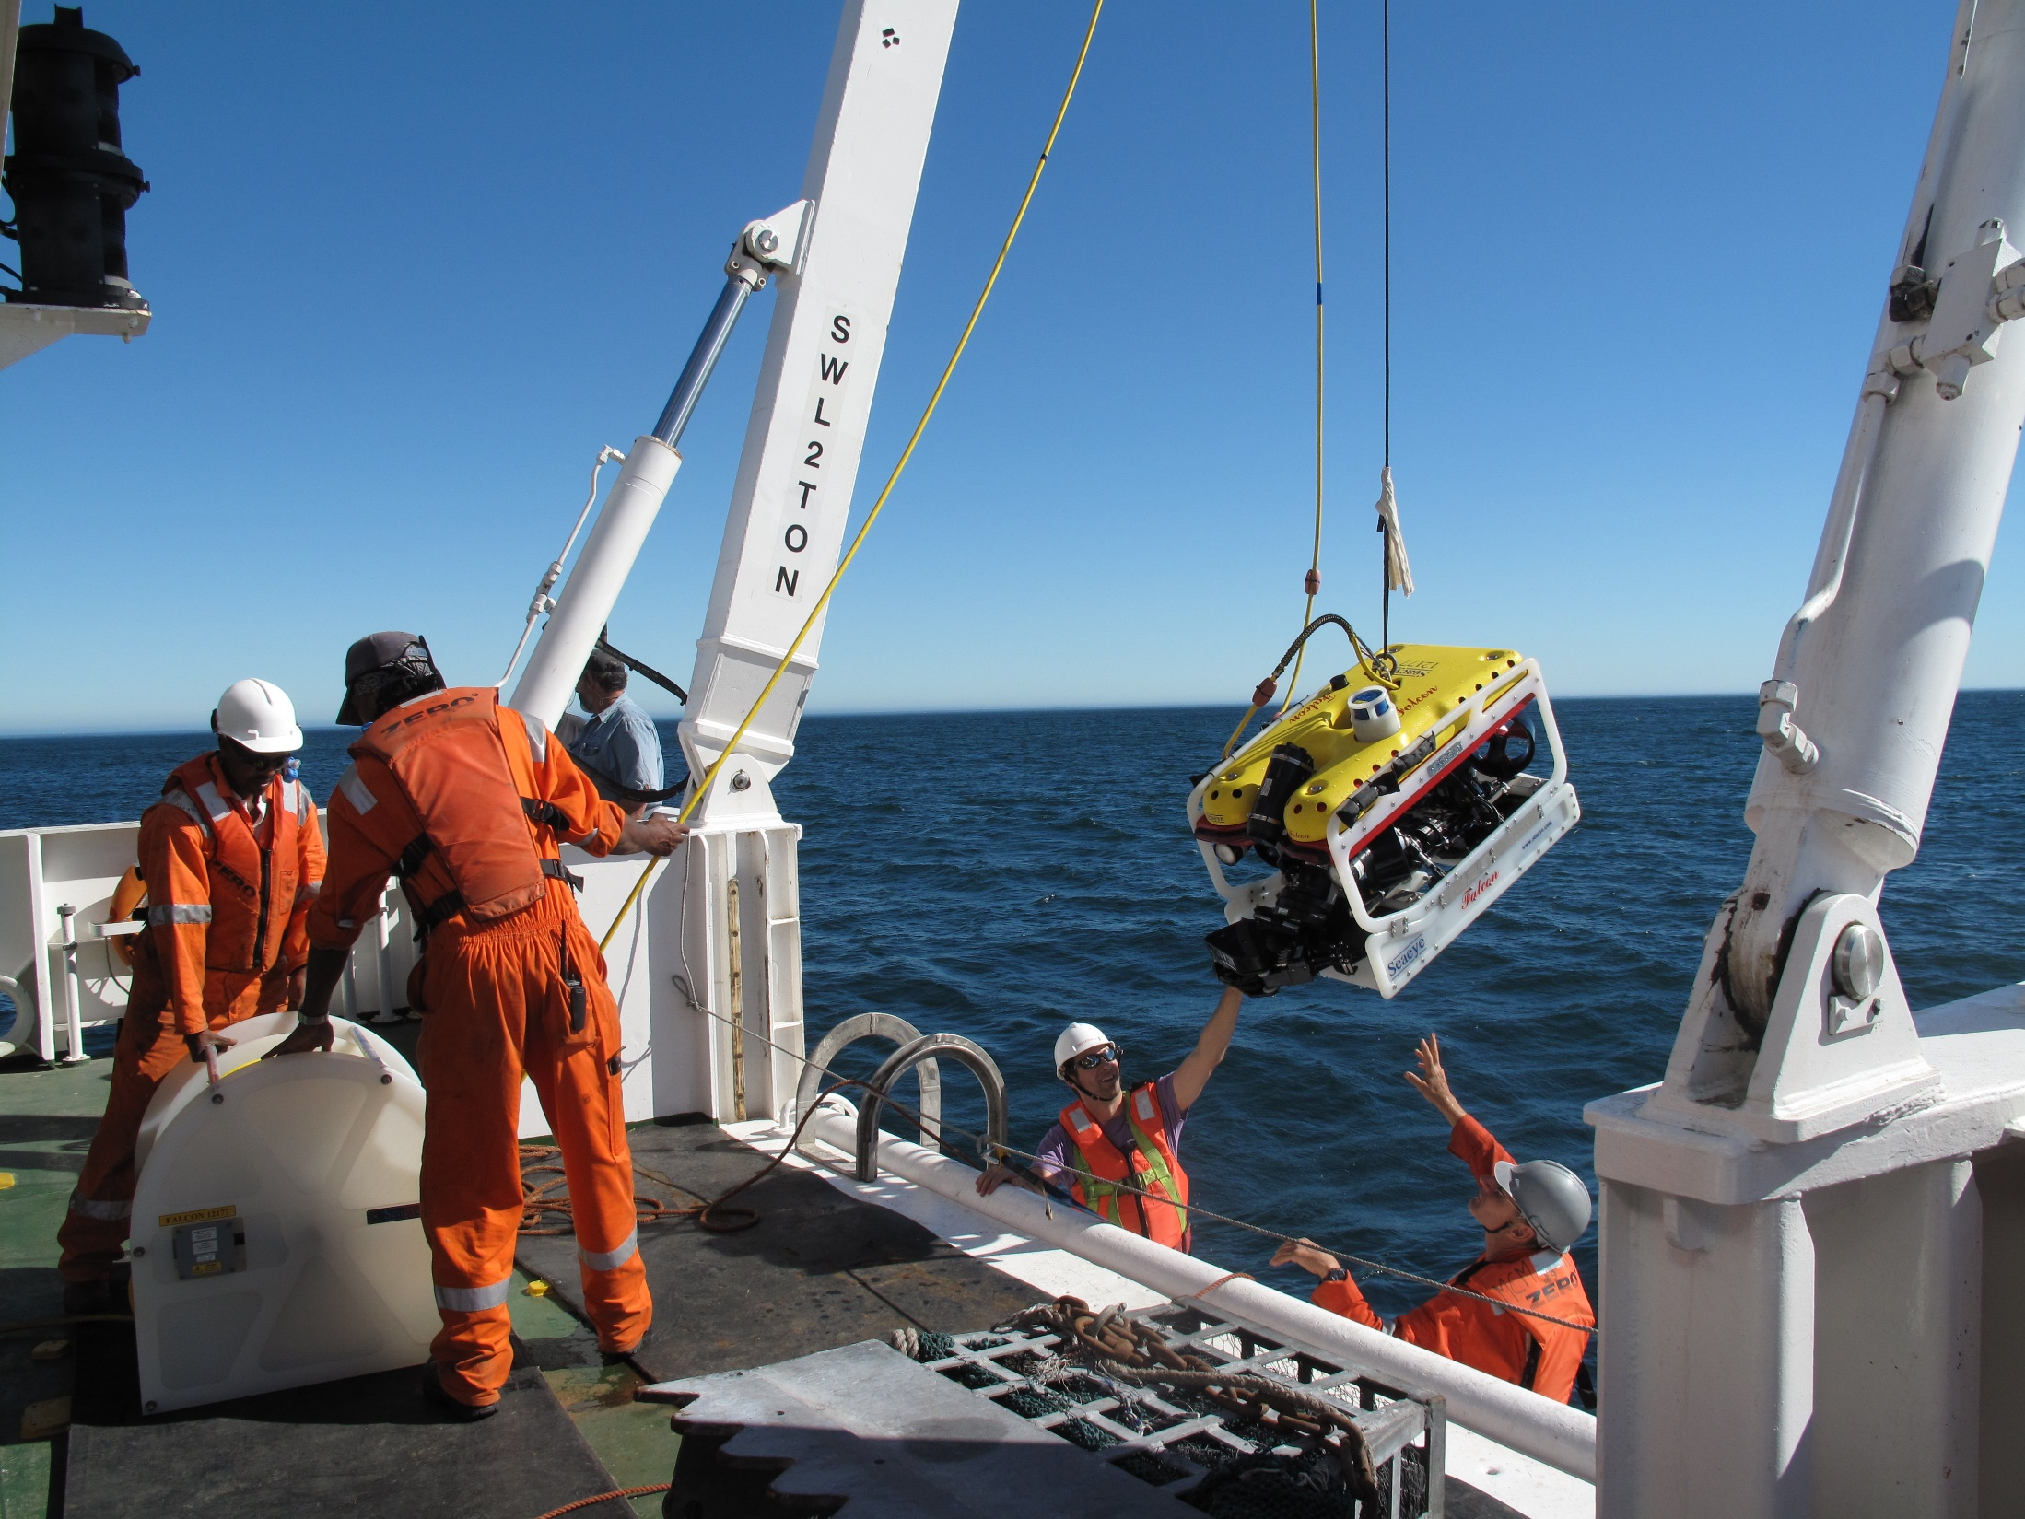
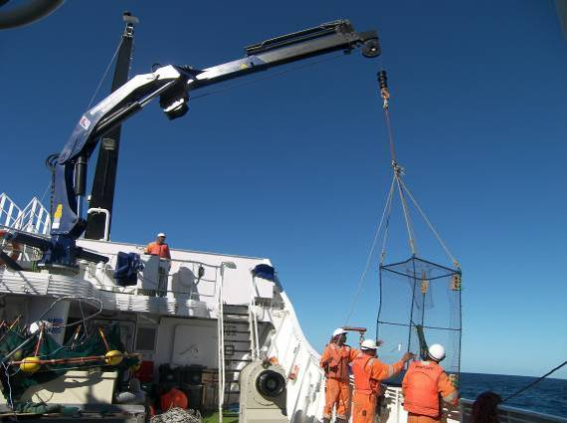
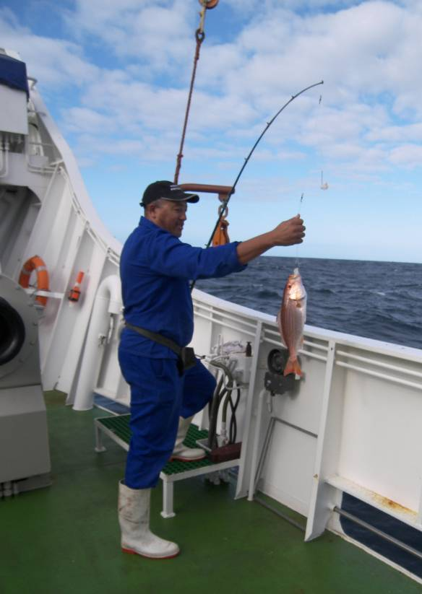
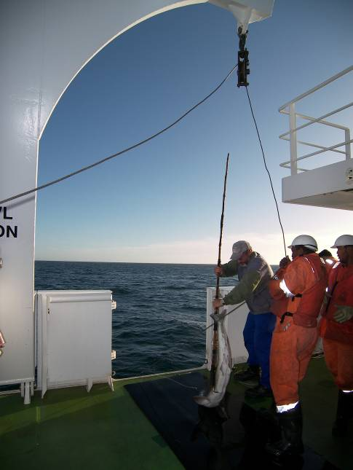
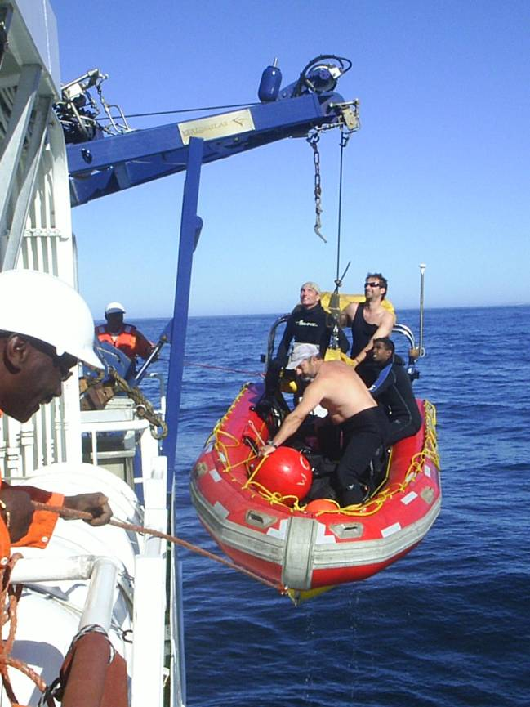
Notes:
Main research methods:
Remotely operated vehicle (or ROV)
Fish trap deployments
Controlled angling

Slide 15
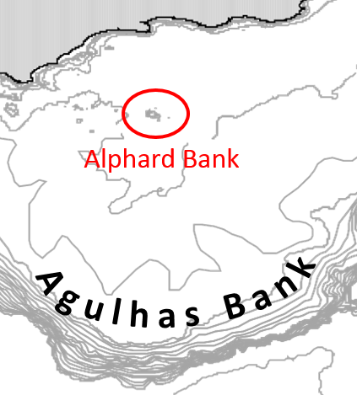
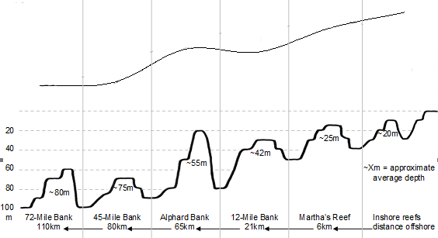
offshore
S
N
inshore
Fish Diversity
Alphard Bank
Notes:
We looked at other hard substrate habitats such as banks and reefs on the Agulhas Bank.
When comparing these hard substrate habitats, there was a general trend of higher diversity inshore compared to offshore due to higher environmental variability inshore (e.g. light, turbulence, nutrients, etc).
Alphard Bank pinnacles broke this pattern spatially by a higher than expected fish diversity.
This pattern is likely due to the steeper topography of the pinnacles compared to the flatter banks.
=> Alphard Bank a good candidate for spatial protection with a MPA

Slide 16
Case Study – Seamounts/Knolls
Seamount (Knoll) of Walters Shoal on the Madagascar Ridge, International Waters

Slide 17
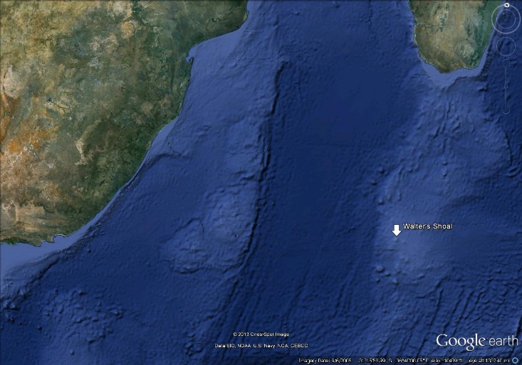
East
Madagascar
Current
Madagascar Ridge
Mozambique
Current
Notes:
Walter’s Shoal is on the latitude of Port Elizabeth but influenced by the East Madagascar Current connecting it downstream with tropical waters.
The trip to Walter’s Shoal from South Africa took about one week, with 2 weeks of working time and a weeks trip back.
Time was limited.

Slide 18
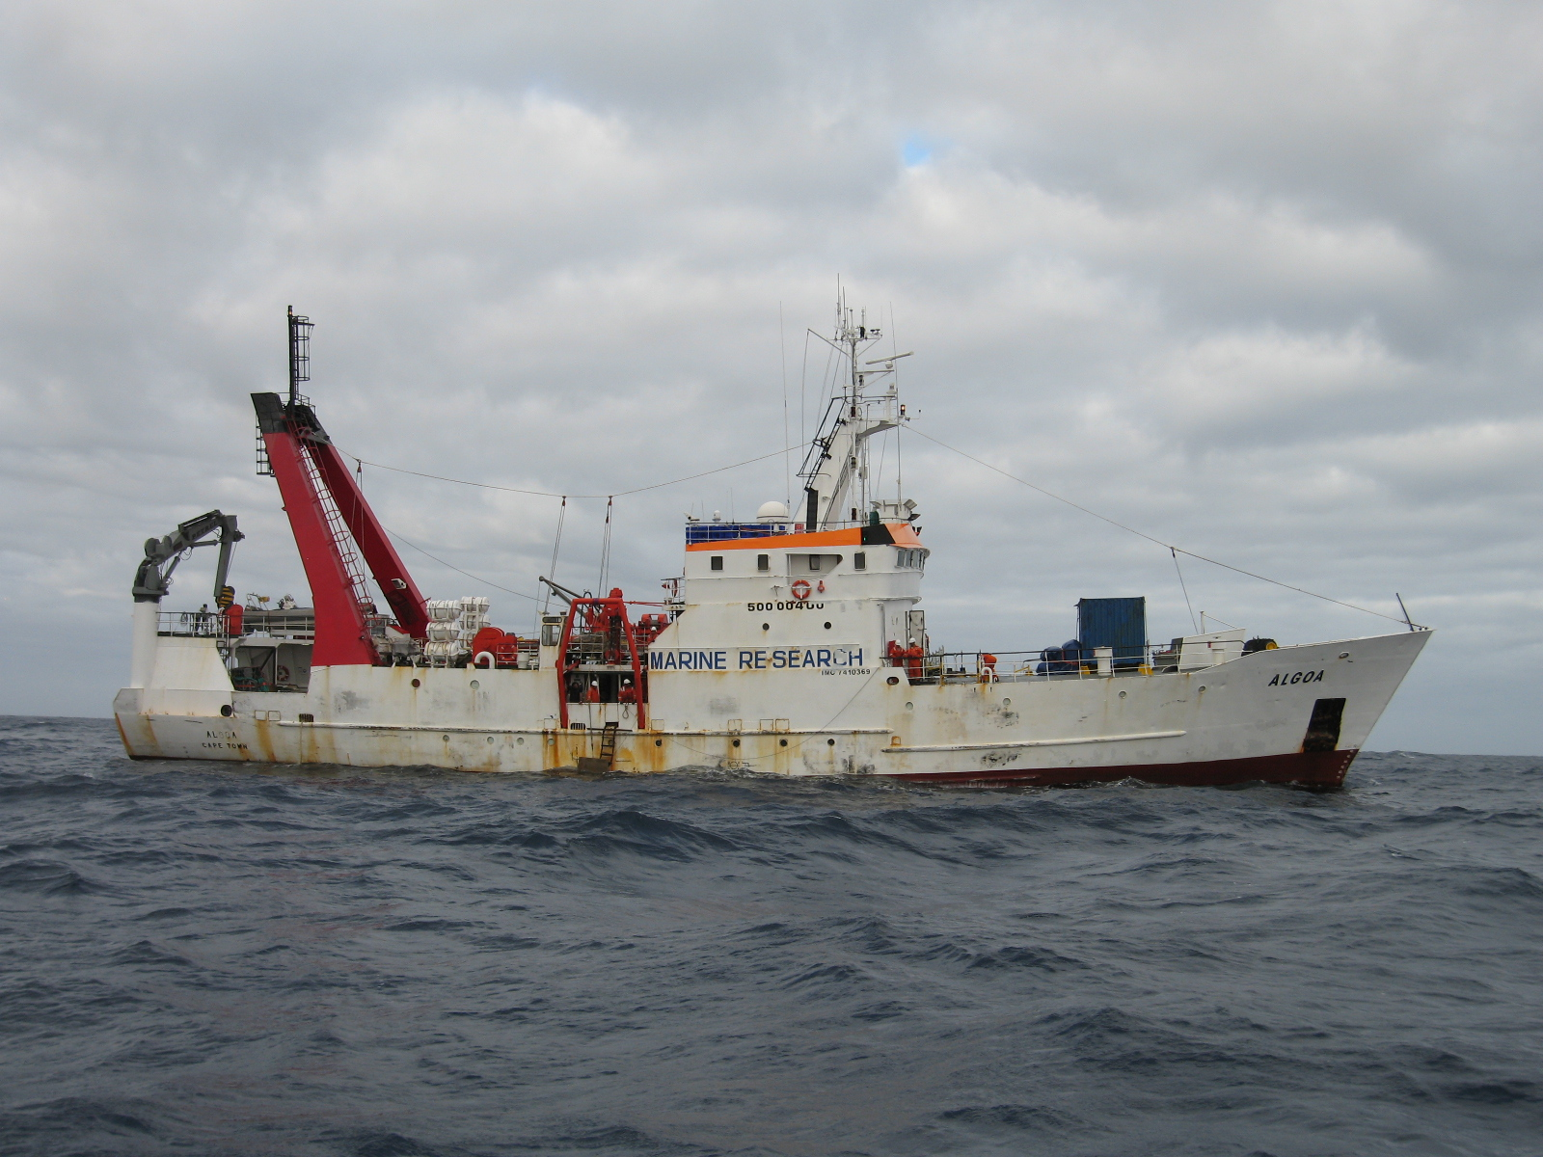
Notes:
Research vessel was the Algoa

Slide 19
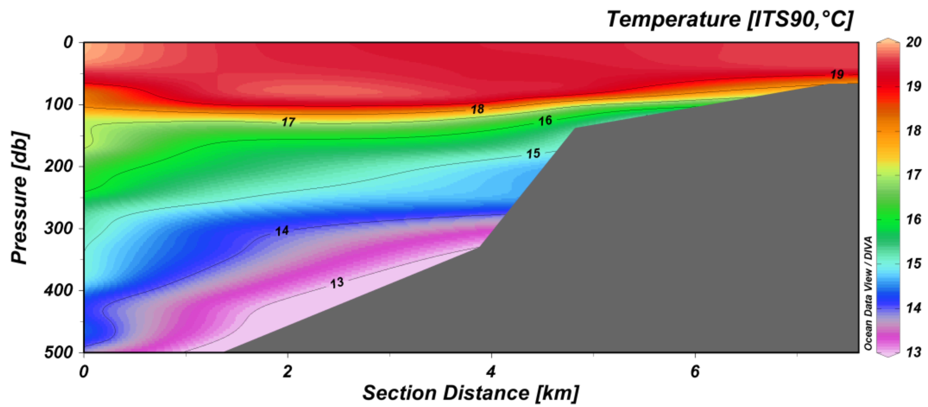
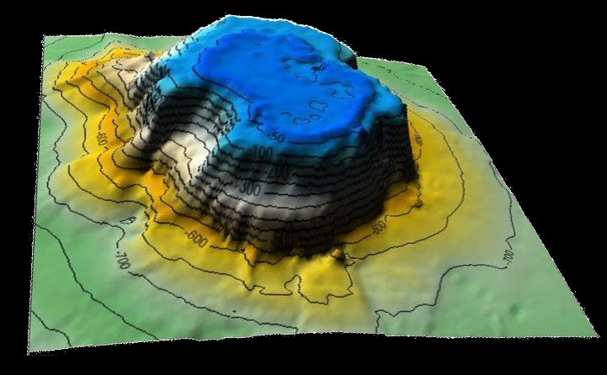
Notes:
Bathymetric mapping revealed that Walter’s Shoal was rather a knoll than a seamount as it only rises about 700m from the surrounding seafloor (see slide).
It also had a flat top consistent with tablemounts and a high likelihood that Walter’s Shoal was an island in its geological past.
Temperature profiles (see insert) show that cold water is pushed up the slope of the structure which may also lead to cold upwelling and associated plankton blooms.

Slide 20
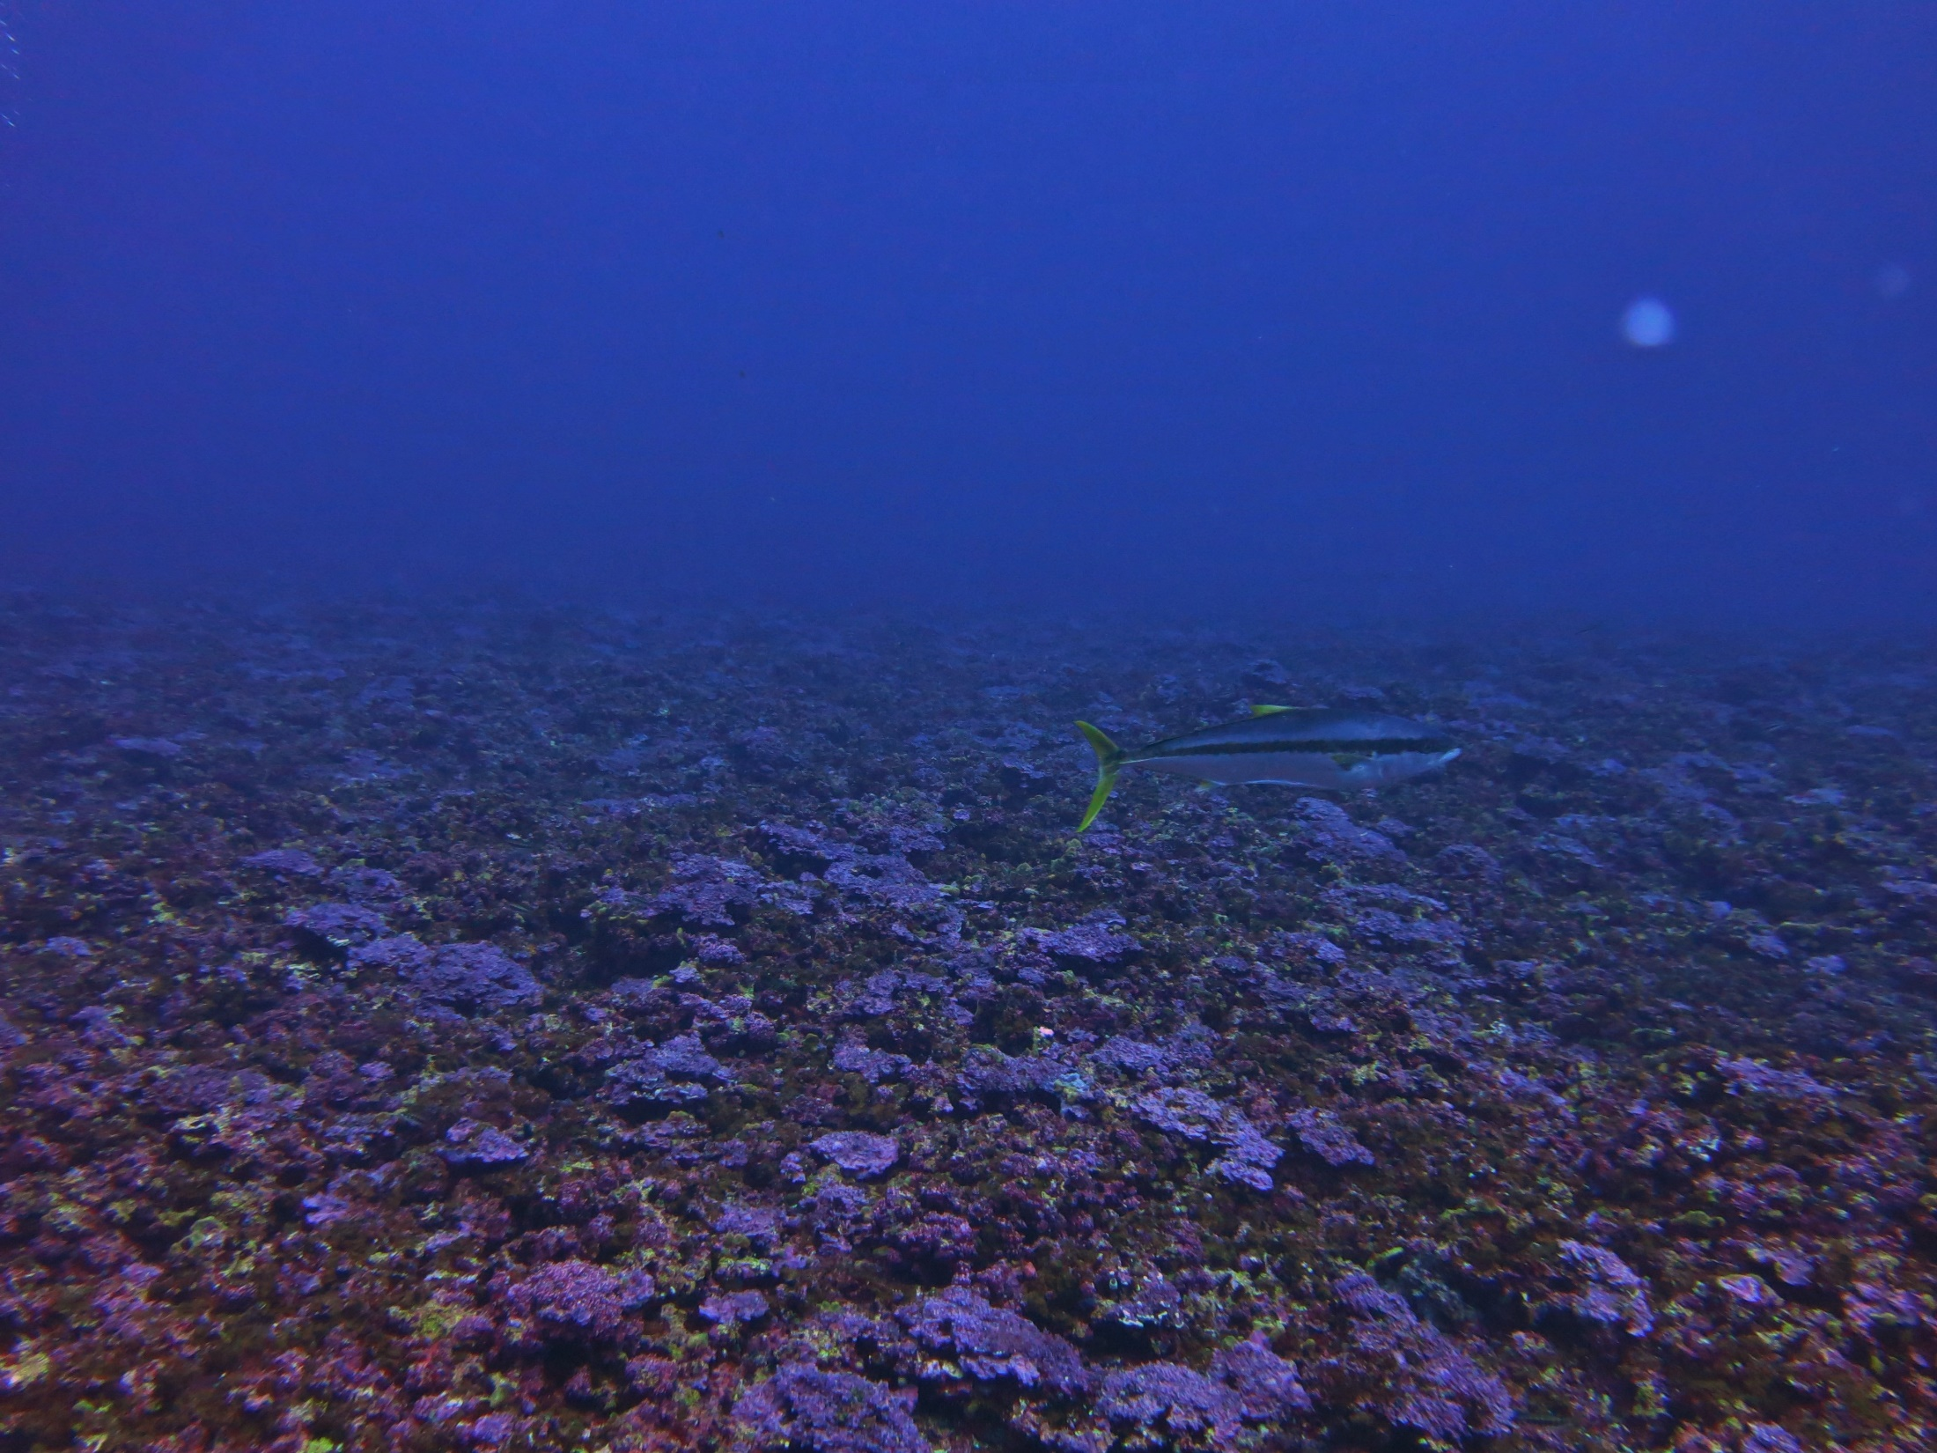
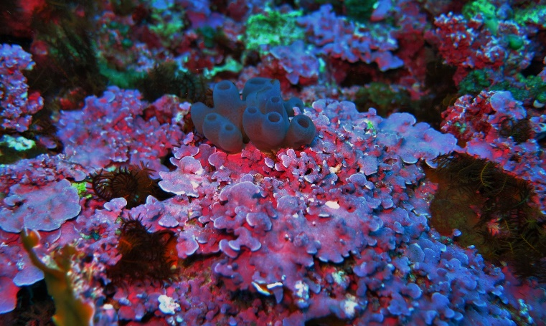
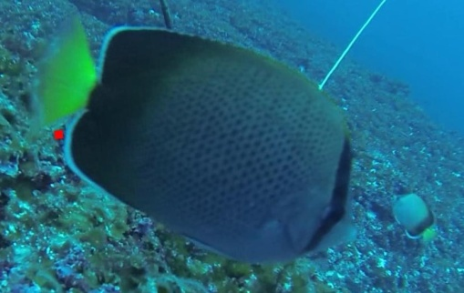
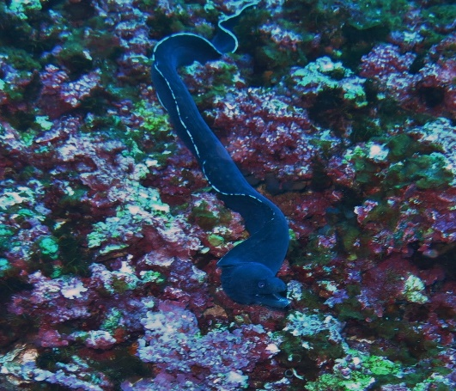
coralline algae
Chaetodon dolosus
Gymnothorax parini
giant yellowtail
Notes:
Biological sampling was conducted through diving surveys as well as drop cameras.
Coralline algae (see slide and insert) were the dominant invertebrate cover best comparable to reefs in warm-temperate continental shelf areas.
The fish fauna, however, was more similar to sub-tropical or tropical areas comprised of Indian Ocean species such as butterfly fishes (see insert), but also wider ranging cosmopolitan species such as yellowtail (see slide).
Additionally, a few endemic species were found such as the Walter’s Shoal moray eel (see insert).
Basic predictions relating to the ecology of seamounts were also true at Walter’s Shoal:
=> increased levels of endemism
=> FAD for wide ranging species
=> habitat for species not otherwise occurring in the surrounding area

Slide 21
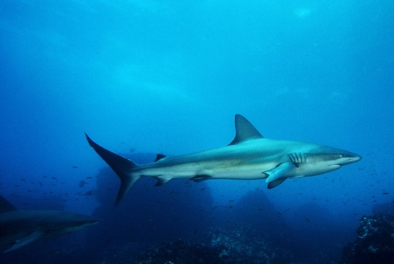
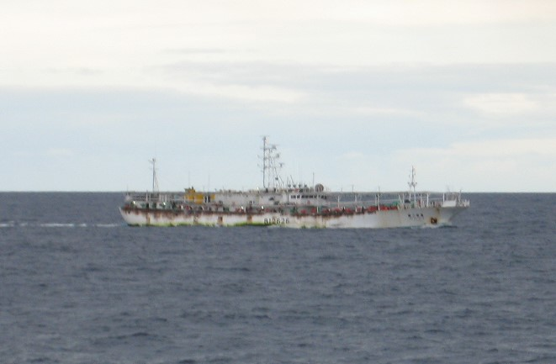
Galapagos Shark
(Carcharhinus galapagensis)
Notes:
When discovered in 1963 the seamount supported a large population of Galapagos sharks (see slide; Carcharhinus galapagensis).
However, short after discovery of the seamount, the Walter’s Shoal population was heavily reduced by overfishing.
Since then there were a few scientific expeditions to Walter’s Shoal. None, including the one reported on here reported Galapagos sharks.
What was notable during this expedition was the constant presence of several fishing boats on the Shoal (see insert).
Walter’s Shoal is a reminder of the urgent need for an international framework for seamount directed MPA establishment in international waters.

Slide 22
Conservation of Seamounts with MPAs
Albrecht Götz, Sven Kerwath, Anthony Bernard and Toufiek Samaai
Thanks!

